Slide 1
Large-Scale Graph Analytics
Fangyan Zhang
Major professor: Dr. Song Zhang
Committee Members:
Dr. Song Zhang
Dr. J. Edward Swan II
Dr. Pak Chung Wong
Dr. Andy D. Perkins
Dissertation Defense: October 26, 2017

Slide 2
Outline
Introduction (Chapter 1)
Motivations
Objective
Main Work
Graph Sampling for Visual Analytics(Chapter 2)
Distributed Graph Sampling Methods(Chapter 3)
BGS:A Large-scale Graph Visualization System(Chapter 4)
Conclusion (Chapter 5)
Dissertation: https://github.com/zhangfangyan/Dissertation

Slide 3
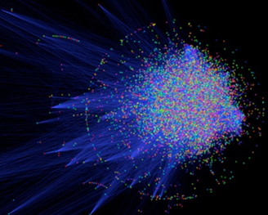
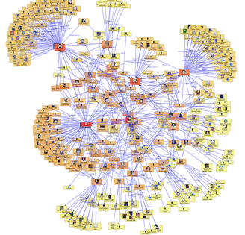
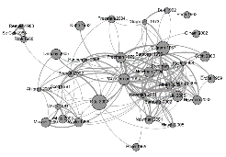
Introduction
Graphs are widely used to represent a variety of information.
……
biological network
social network
citation network

Slide 4
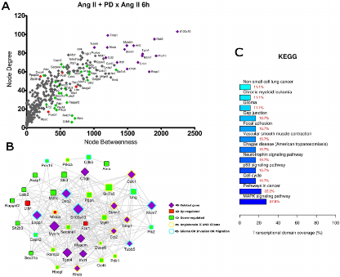
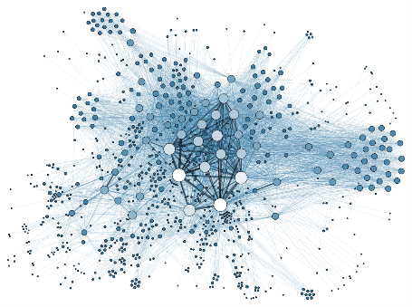
Introduction
Graph Analysis
Graph Visualization
Transcriptional Network Enrichment Analysis
Social Network Visualization

Slide 5
Introduction
Objective
How can we help users gain insights from large- scale graph with billions of nodes or edges using graph visual analytics?
How can we help users explore large-scale graphs (graph properties and graph visualization)?
Graph Sampling
Graph Visualization

Slide 6
Introduction
Why do we evaluate graph sampling methods?
Why do we develop distributed graph sampling methods?
Why do we develop scalable graph visualization tool-BGS?

Slide 7
Introduction
Main topics and publications
Graph Sampling for Visual Analytics (Chapter 2)
Fangyan Zhang, Song Zhang, and Pak Chung Wong. "Graph Sampling for Visual Analytics." Journal of Imaging Science and Technology (2017).
Fangyan Zhang, Song Zhang, Pak Chung Wong, Hugh Medal, Linkan Bian, I. I. Swan, J. Edward, and T. J. Jankun-Kelly. "A Visual Evaluation Study of Graph Sampling Techniques." Electronic Imaging 2017, no. 1 (2017): 110-117.
Fangyan Zhang, Song Zhang, Pak Chung Wong, J. Edward Swan II, and T.J. Jankun-Kelly. A Visual and Statistical Benchmark for Graph Sampling Methods. In Exploring Graphs at Scale (EGAS) Workshop, IEEE VIS 2015, Oct 2015.
Distributed Graph Sampling Methods (Chapter 3)
Fangyan Zhang, Song Zhang, Christopher Lightsey, “Distributed Graph Sampling Methods”, submitted to Electronic Imaging 2018
BGS:A Large-scale Graph Visualization System (Chapter 4)
Fangyan Zhang, Song Zhang, Christopher Lightsey, “BGS: A Large-Scale Graph Visualization Tool”, submitted to Electronic Imaging 2018
Fangyan Zhang, Song Zhang, Christopher Lightsey, “BGS: A Large-Scale Graph Visualization System”, submitted to IEEE Transaction TVCG

Slide 8
1
2
3
Graph Sampling for Visual Analytics
Distributed Graph Sampling Methods
BGS: Big Graph Surfer

Slide 9
Related work
Node Sampling | Edge Sampling | Topology-based Sampling
Random node (RN) | Random edge (RE) | Breadth-first (BF)
Random node-edge (RNE) | Induced edge (IE) | Depth-first (DF)
Random node-neighbor (RNN) |  | Random first (RF)
 |  | Snowball (SB)
 |  | Random walk (RW)
 |  | Random walk with escape (RWE)
 |  | Forest fire (FF)

Slide 10
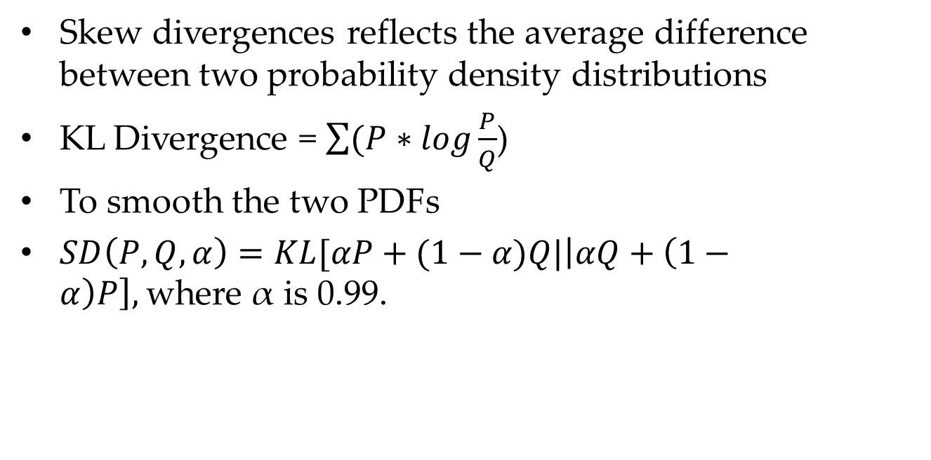
Methodology
Skew divergences reflects the average difference between two probability density distributions
KL Divergence = $\sum{(P∗log\frac{P}{Q}}$)
To smooth the two PDFs
$SD\left(P, Q, α\right)=KL[αP+(1−α)Q|\left|αQ+\left(1−α\right)P\right],$where α is 0.99.

Slide 11
Methodology
Graph Properties(Undirected Graph) | Graph Properties(Directed Graph)
Degree(DD) | In-degree(InDD)
Average neighbor degree(ANDD) | Out-degree(OutDD)
Degree centrality(DCD) | In degree centrality(InCD)
Node betweenness centrality(NBCD) | Out degree centrality(OutCD)
Edge betweenness centrality(EBCD) | Average neighbor degree(ANDD)
Local clustering coefficient(LCCD) | Node betweenness centrality(NBCD)
Closeness centrality(CCD) | Edge betweenness centrality(EBCD)
Eigenvector centrality(EVCD) | Closeness centrality(CCD)
 | Eigenvector centrality(EVCD)

Slide 12
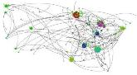
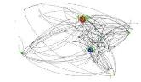
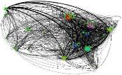
Methodology
Visual comparison
Original Graph
Visualize it in Gephi with decorations
Save decorated graph
Sampling on decorated graph
.graphml
.edges
.csv
RN
RE
…
.graphml
.edges
.csv
…

Slide 13
Graph Datasets
Dataset | Graph Type | Model | # Vertices | # Edges
Random | Directed | Model | 10,000 | 100,246
Small-World | Undirected | Model | 10,000 | 21,895
Scale-Free | Directed | Model | 10,000 | 18,838
Email | Directed | Real | 265,214 | 420,045
Citation | Directed | Real | 34,546 | 421,578
Internet | Directed | Real | 10,876 | 39,994
Facebook | Undirected | Real | 4,039 | 88,234
U.S. Flight | Undirected | Real | 235 | 1,297
Stanford SNAP datasets: https://snap.stanford.edu/data/

Slide 14
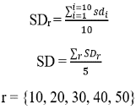
Statistical Comparisons
SD value
SD value
property
property
SD value
SD value
property
property

Slide 15
Statistical Comparisons
SD value
SD value
property
property
SD value
SD value
property
property

Slide 16
Analysis: Statistical Comparisons

Slide 17
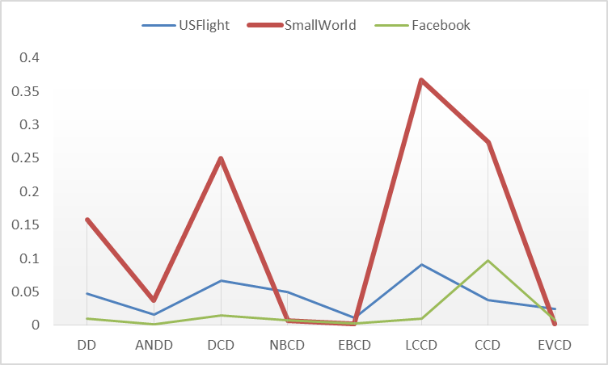
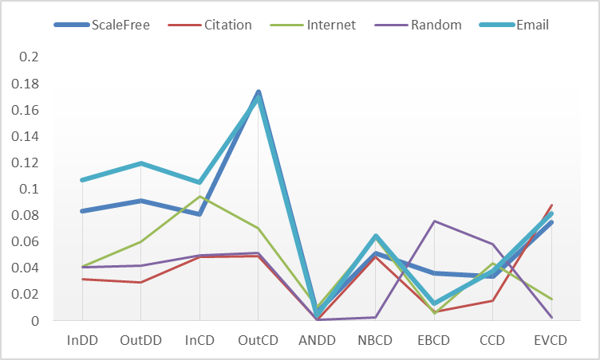
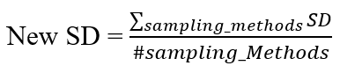
Analysis: Statistical Comparisons
SD value
SD value
property
property

Slide 18
Visual Comparison
Facebook graph; Sampling rate: 10 % on edges

Slide 19
Analysis: Visual Comparison
Spatial coverage
Random sampling methods > Topology-based sampling
Clusters
Edge-related sampling methods > Node sampling
Edge-related sampling methods > Topology-based sampling

Slide 20
Analysis: Comparison in Efficiency
time(seconds)
sampling rate
Facebook

Slide 21
Conclusion
When choosing sampling methods, we need to consider the four following factors:
graph type
graph property
sampling efficiency
visual requirements

Slide 22
1
2
3
Graph Sampling for Visual Analytics
Distributed Graph Sampling Methods
BGS: Big Graph Surfer

Slide 23
Methodology
Distributed Node Sampling | Distributed Edge Sampling | Distributed Topology-based Sampling
Random Nodes (RN) | Random Edge (RE) | Breadth-First (BF)
Random Node-Edge (RNE) | Random Hybrid (RH) | Forest Fire (FF)
Random Node-neighbor (RNN) | Induced Edge (IE) | Snowball (SB)

Slide 24
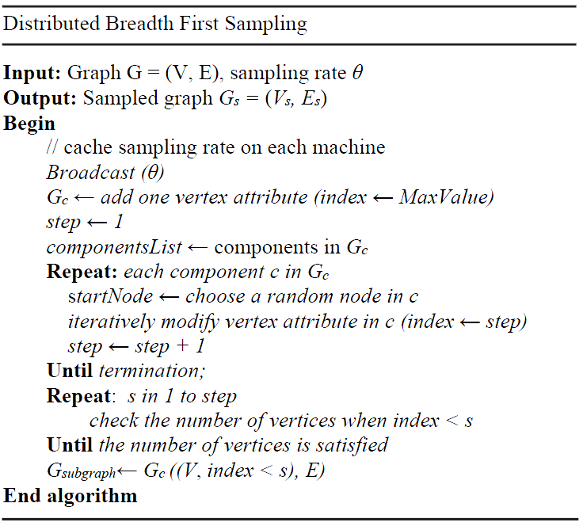
Methodology
Distributed Topology-based Sampling
Two challenges:
Not easy to create visited index
Multiple unconnected components in a graph.
Solution
Two stages: vertex labeling and sampling
Check components in the graph
Indicate each vertex with an index number

Slide 25
Implementation
Platforms or packages used
Spark (a fast and general engine for large-scale data processing)
GraphX (Apache Spark's API for graphs and graph-parallel computation)
Pregel (A system for large-scale graph processing, developed by Google)
The distributed sampling algorithms are written in Scala language and compiled into a JAR file for distribution.

Slide 26
Usage
Package Usage (Example)
import msu.dasi.distributedSamplingMethods._
……
val conf = new SparkConf().setAppName("Sampling").setMaster("local[*]")
val sc = new SparkContext(conf)
val graph = GraphLoader.edgeListFile(sc, “…/friendster.txt", true).partitionBy(PartitionStrategy.RandomVertexCut)
val percent = 0.15
randomNodeGraph = randomNode(sc, percent, graph)
……

Slide 27
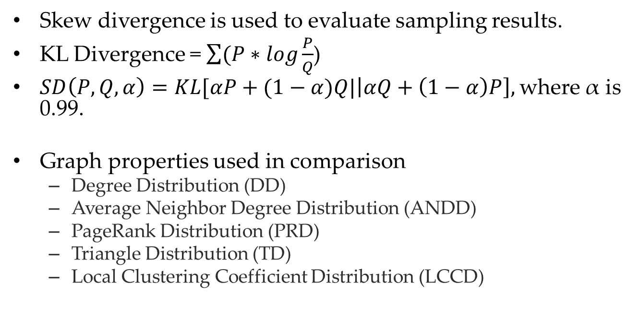
Methodology
Skew divergence is used to evaluate sampling results.
KL Divergence = $\sum{(P∗log\frac{P}{Q}}$)
$SD\left(P, Q, α\right)=KL[αP+(1−α)Q|\left|αQ+\left(1−α\right)P\right],$where α is 0.99.
Graph properties used in comparison
Degree Distribution (DD)
Average Neighbor Degree Distribution (ANDD)
PageRank Distribution (PRD)
Triangle Distribution (TD)
Local Clustering Coefficient Distribution (LCCD)

Slide 28
Graph Datasets
Datasets | Type | Model | Nodes | Edges
Facebook | Undirected | SNAP | 4,039 | 88,234
Amazon | Undirected | SNAP | 334,863 | 925,872
Friendster | Undirected | SNAP | 65,608,366 | 1,806,067,135
SNAP: https://snap.stanford.edu/data/
Sampling Rate:
15% based on vertices
25% based on vertices
5 different runs

Slide 29
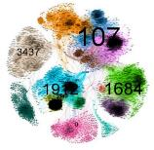
Visual Comparison Results
Original Facebook Graph
Sampling rate: 15%

Slide 30
Statistical Comparison Results
SD value
SD value
property
property
Facebook
SD value
SD value
property
property

Slide 31
Statistical Comparison Results
SD value
SD value
property
property
Amazon
SD value
SD value
property
property

Slide 32
Efficiency Comparison Results
time(seconds)
time(seconds)
sampling method
sampling method
time(seconds)
time(seconds)
sampling method
sampling method
time(seconds)
time(seconds)
sampling method
sampling method

Slide 33
Analysis
Statistical comparison
Visual comparison
Efficiency comparison
Scalability

Slide 34
1
2
3
Graph Sampling for Visual Analytics
Distributed Graph Sampling Methods
BGS: Big Graph Surfer

Slide 35


Related work
Tools | Representation | Hierarchy | Graph-scale | Pros and cons | Choice
ZAME[1] | Adjacency matrix | Pyramid aggregation | Million scale | Pros: fast rendering using GPU, fit for large graphs Cons: not easy to identify interesting structure
ASK-GraphView[2] | Node-link | MCL clustering | Million scale | Pros: fit for large graphs, automatically cluster on large graphs Cons: context not helpful in vertical navigation, no crossover edges
TeGViz[3] | Adjacent matrix | No hierarchy | billion scale | Pros: scalable, fit for large graphs Cons: no clustering and hierarchy, only work for random graph, R-MAT/Kronecker
Vizster[4] | Node-link | No hierarchy | Less than million scale | Pros: easy to use, support visual search and analysis Cons: only fit for small graphs
Network Explorer[5] | Node-link | No hierarchy | Less than million scale | Pros: easy to expand or collapse clusters Cons: not scalable, only fit for small graphs
GraphVizdb[6] | Node-link | Abstraction layers | Million scale | Pros: scalable, support keyword search Cons: no relation between layers, does not support vertical navigation
Matrix Zoom[7] | Matrix view | Clustering with relational constraint | Million scale | Pros: scalable, deal with semi-external graph Cons: limitation in clustering methods

Slide 36
Related work
Pros and cons of hierarchy
Balance Pros and Cons
Hierarchy | Pros | Cons
 | Provide overview for large graphs [2]; Increase visualization efficiency; reduce overlaps in visualization, etc. | Not easy to construct hierarchical structure[7]; easy to lose context while navigating in hierarchy; vertices may be not evenly distributed in hierarchy, etc.

Slide 37
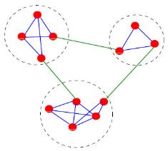
Related work
Divisive algorithms
which work from top to bottom by detecting inter-cluster links and removing them recursively.
Newman clustering algorithm[8] O (|V|*|E|)
Agglomerative algorithms
which start from its own singleton cluster, and merge similar clusters recursively.
MCL clustering algorithm[9] O (|V|³)
Optimization algorithms
These algorithms usually use a modularity value as an object function to measure the quality of clustering. They adjust clusters in each step trying to increase modularity values as high as possible.
Louvain clustering algorithm[10] O (|V|)

Slide 38
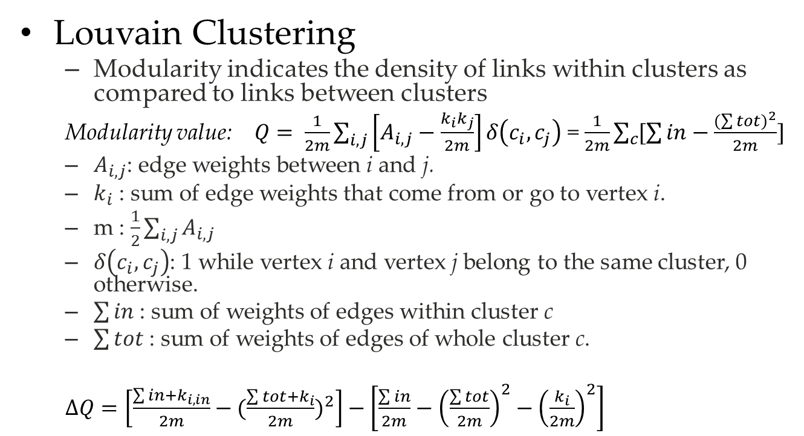
Related work
Louvain Clustering
Modularity indicates the density of links within clusters as compared to links between clusters
Modularity value: $Q= \frac{1}{2m}\sum_{i, j}{\left[A_{i, j}−\frac{k_{i}k_{j}}{2m}\right]δ\left(c_{i},c_{j}\right)}$ = $\frac{1}{2m}\sum_{c}{[\sum{in}−\frac{{(\sum{tot})}^{2}}{2m}]}$
$A_{i, j}$: edge weights between i and j.
$k_{i}$ : sum of edge weights that come from or go to vertex i.
m : $\frac{1}{2}\sum_{i, j}{A_{i, j}}$
$δ\left(c_{i},c_{j}\right)$: 1 while vertex i and vertex j belong to the same cluster, 0 otherwise.
$\sum{in}$ : sum of weights of edges within cluster c
$\sum{tot}$ : sum of weights of edges of whole cluster c.
$∆Q=\left[\frac{\sum{in}+k_{i, in}}{2m}−{(\frac{\sum{tot}+k_{i}}{2m})}^{2}\right]−\left[\frac{\sum{in}}{2m}−{\left(\frac{\sum{tot}}{2m}\right)}^{2}−{\left(\frac{k_{i}}{2m}\right)}^{2}\right]$

Slide 39
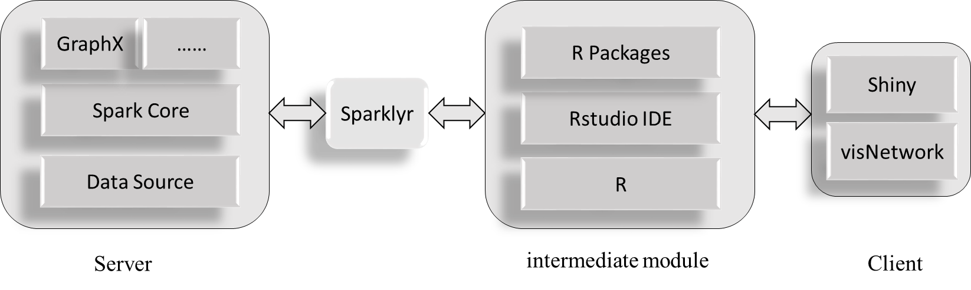
Methodology: Architecture & Layout
Architecture
Layout
Thirteen graph layouts (iGraph)
Real-time computation

Slide 40
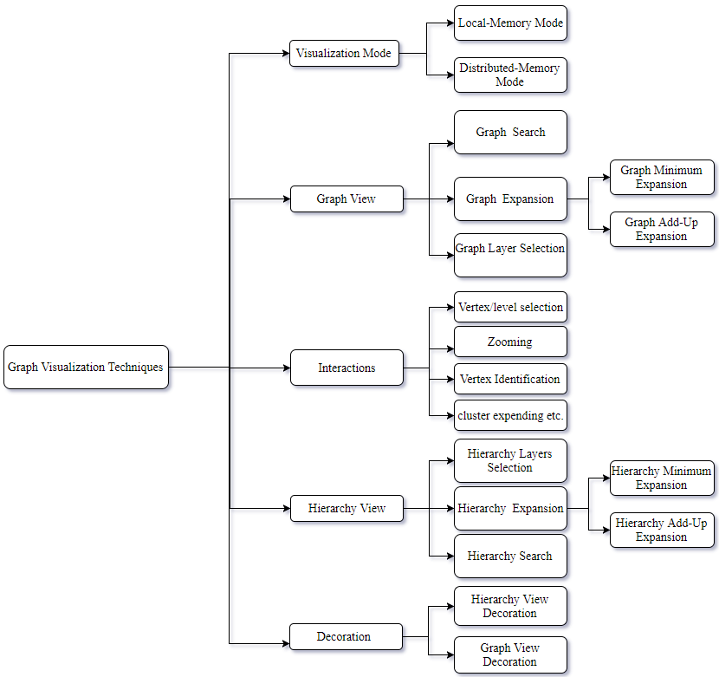

Slide 41
Methodology: Hierarchy View and Graph View
Hierarchy View and Graph View
Expanded cluster 20
22
19
15
19
20
21
16
13
14
15
16
17
18
17
18
1
2
3
4
5
6
7
8
9
10
11
12
Expanded cluster 21
Hierarchy View
Graph View

Slide 42
Methodology: Expansion Mode
Minimum mode
The previously expanded clusters or nodes will be automatically collapsed into a cluster.
This mode maintains high efficiency in large-scale graph visualization.
Add-Up mode
The previously expanded clusters or nodes will be preserved.
We can observe detailed relations among multiple clusters or nodes.

Slide 43
Methodology: Hierarchy Exploration
Hierarchy Layers Selection
If one hierarchy has depth h, and the initial hierarchy has s layers, then the initial hierarchy is {Ti, h-s +1 < i <=h} which provides informative context for users to explore the graph hierarchy.
The several top levels in the hierarchy will consistently exist with expanding clusters.
.
.
.
.
.
.
.
.
.
…
…
Layers Selection

Slide 44
Methodology : Hierarchy Exploration
Hierarchy Expansion
Minimum Mode
Add-Up Mode
Note: Hierarchy Layers Selection = 3
22
22
22
19
20
21
19
20
21
19
20
21
13
14
15
16
17
18
13
14
15
16
17
18
13
14
15
16
17
18
expand
7
8
1
2
expand
Collapse
22
22
22
19
20
21
19
20
21
19
20
21
13
14
15
16
17
18
13
14
15
16
17
18
13
14
15
16
17
18
expand
7
8
1
2
7
8
expand

Slide 45
Methodology: Hierarchy Exploration
Hierarchy Search
Note: Hierarchy Layers Selection = 2
22
22
19
20
21
19
20
21
13
14
13
14
17
18
1
2
1
2
9
10
Minimum mode
Add-Up mode

Slide 46
Visualization: Graph Exploration
Graph Layer Selection
Initially, BGS visualizes the top layer graph Gh (h is the depth of the hierarchy) in graph view.
Users are permitted to select another starting layer Gi to visualize.
.
.
.
.
.
.
.
.
.
…
…
Layer Selection

Slide 47
Methodology: Graph Exploration
Graph Expansion
Minimum Mode
Add-Up Mode
expand
19
20
19
20
19
15
16
21
17
18
21
expand
collapse
expand
19
20
19
20
19
15
16
21
17
18
17
18
expand

Slide 48
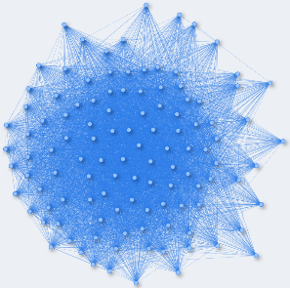
Methodology: Graph Exploration
Graph View mode
Regular Mode
Edge-Free Mode
19
20
19
20
19
20
21
21
21
(a)
(b)
(c)
Increase readability
Improve efficiency

Slide 49
Methodology: Graph Exploration
Graph Search
19
20
15
19
20
15
search
search
16
16
21
18
21
17
18
Search 16
Search 16 and 18

Slide 50
Methodology: Visualization Mode
Local-Memory mode
Designed for small graphs
Graph data can be completely loaded into main memory.
Crossover edge generation is done on local machine.
Distributed-Memory mode
Designed for large-scale graphs.
Graph and its hierarchy data are distributed into multiple machines.
To minimize the data requests to Spark, only required data is retrieved from Spark.

Slide 51
Methodology: Decorations and Interactions
Decorations and Interactions
Zooming in/out
Adjust the viewpoint to observe details.
Vertex identification
To find out one vertex
Vertex selection and layer selection
To select one vertex or a group of vertices

Slide 52
Case Study
BGS Functionalities
BGS Scalability
Interactions

Slide 53
Case Study
BGS Scalability
Table 1: clustering time, loading time, and visualization time for graph datasets
Interactions
zooming in or out
vertex identification
vertex selection or level selection
clusters expanding etc.

Slide 54
Discussion
Table 2: Combination of visualization mode and expansion mode

Slide 55
Contributions
Graph Sampling
Built a benchmark for evaluating graph sampling methods with both visual and statistical properties
Develop a large-scale graph sampling package including nine scalable graph sampling methods based on Spark.
Make a visual and statistical comparison between traditional/non-distributed sampling methods and distributed graph sampling methods.
Analyze nine distributed graph sampling methods from visual and statistical perspective.
Graph Visualization
Present a scalable graph visualization system-BGS
Present an efficient hierarchy construction algorithm based on a tuned Louvain clustering.
Design and develop two well-designed view modes, two hierarchy and graph expansion modes, and two visualization modes, direct search on hierarchy view and graph view by vertices attribute(s) or edges attribute(s) in BGS.

Slide 56
Reference
[1] N. Elmqvis, T. N. Do, H. Goodell, N. Henry, and J. D. Fekete, “ZAME: Interactive large-scale graph visualization,” IEEE Pacific Vis. Symp. 2008, PacificVis - Proc., pp. 215–222, 2008.
[2] J. Abello, F. Van Ham, and N. Krishnan, “ASK-Graph View: A large scale graph visualization system,” IEEE Trans. Vis. Comput. Graph., vol. 12, no. 5, p. 669, 2006.
[3] B. Jeon, I. Jeon, and U. Kang, “TeGViz: Distributed Tera-Scale Graph Generation and Visualization,” in 2015 IEEE International Conference on Data Mining Workshop (ICDMW), 2015, pp. 1620–1623
[4] J. Heer, “Vizster : Visualizing Online Social Networks,” 2003.
[5] J. A. Guerra-gomez, A. Wilson, J. Liu, and D. Davies, “Network Explorer : Design , Implementation , and Real World Deployment of a Large Network Visualization Tool,” Proc. Int. Work. Conf. Adv. Vis. Interfaces - AVI ’16, pp. 108–111, 2016.
[6] N. Bikakis, J. Liagouris, M. Krommyda, G. Papastefanatos, and T. Sellis, “GraphVizdb: A scalable platform for interactive large graph visualization,” in 2016 IEEE 32nd International Conference on Data Engineering, ICDE 2016, 2016, pp. 1342–1345.
[7] J. Abello and F. Van Ham, “Matrix zoom: A visual interface to semi-external graphs,” in Proceedings - IEEE Symposium on Information Visualization, INFO VIS, 2004, pp. 183–190.
[8] M. Girvan and M. E. J. Newman, “Community structure in social and biological networks.,” Proc. Natl. Acad. Sci. U. S. A., vol. 99, pp. 7821–7826, 2002.
[9] S. van Dongen, “Graph clustering by flow simulation,” Graph Stimul. by flow Clust., vol. PhD thesis, p. University of Utrecht, 2000.
[10] V. D. Blondel, J. Guillaume, R. Lambiotte, and E. Lefebvre, “Fast unfolding of community hierarchies in large networks,” Networks, pp. 1–6, 2008.

Slide 57
Questions? Thank you! Fangyan Zhang Email: fz56@msstate.edu

